Slide 1
Introduction to UI framework and libraries
week3

Slide 2
Working with libraries
Open html file
Add CSS library to html head
Open html ifle with css library
Add javascript library to html body
Add button element

Slide 3
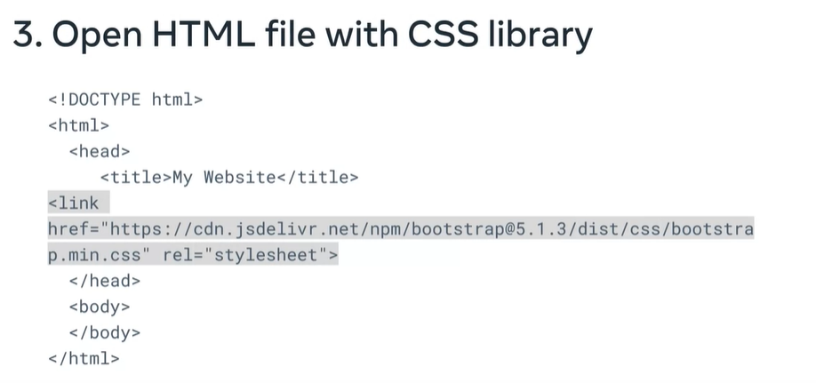
2. Add css lib to html head
<link href=http:// rel=“stylesheet”>

Slide 4
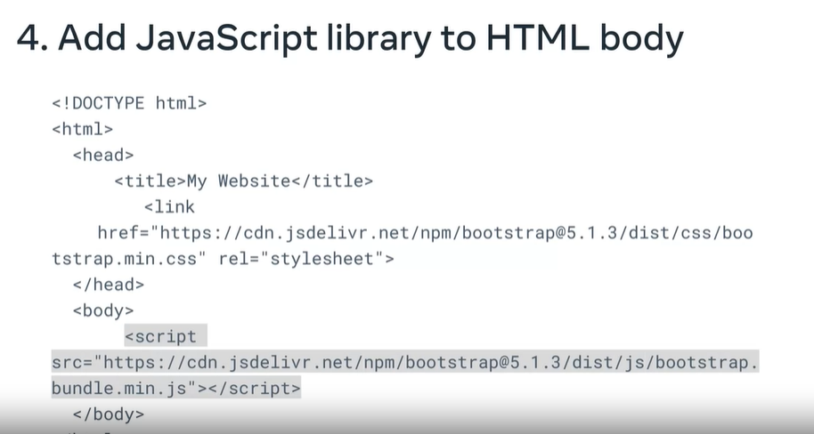
4. Add javascript library to html body
script tag
src attribute

Slide 5
5. Add button element
<button type=“button” class=“btn btn-primary”>Click this button!</button>
Button tag
Type attribute
class attribute
What you want to show on the page

Slide 6
package manager
If there is a dependency tree, the package manager takes care of that for you.
It will automatically download all of the dependency tree so that you can use APIs without dependency issues.
The most common package manager for front end development is the Node Package Manager or npm for sure.

Slide 7
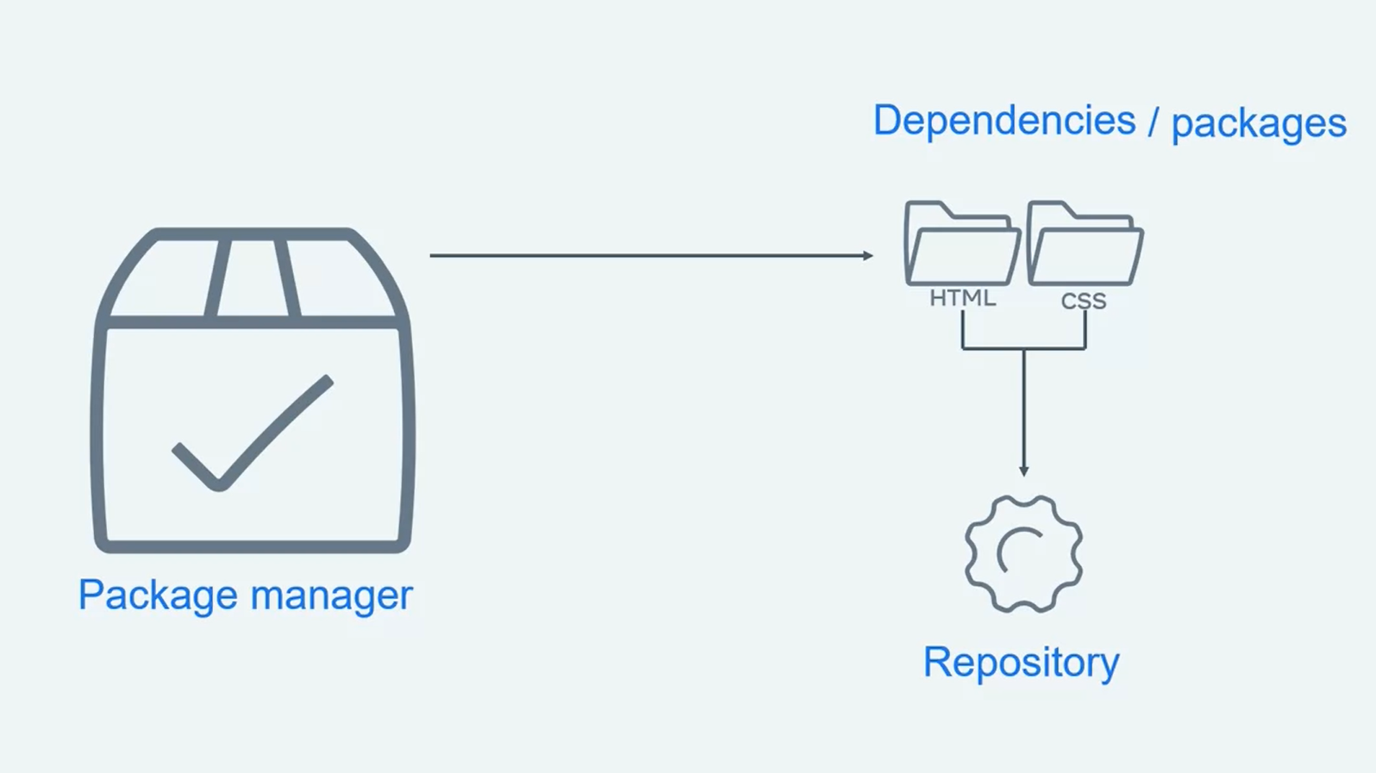
package manager

Slide 8
Buddling tool
The purpose of a bundler is to automatically combine them into a single file.
If you're bundle is significantly large, many bundles can split your dependencies into multiple bundles.
There are many bundle is available such as Gulp and Webpack

Slide 9
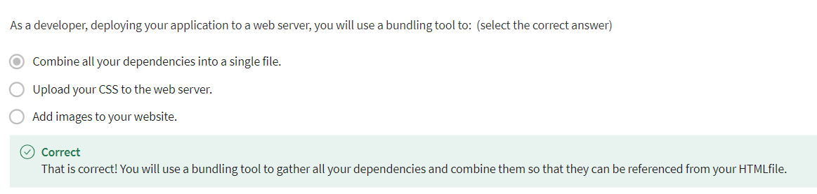

Slide 10
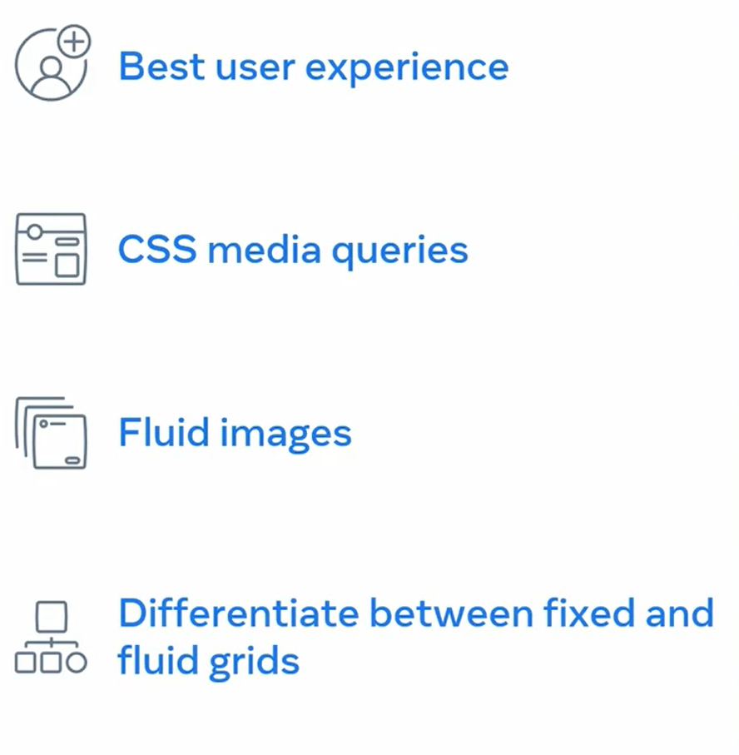
What to learn

Slide 11
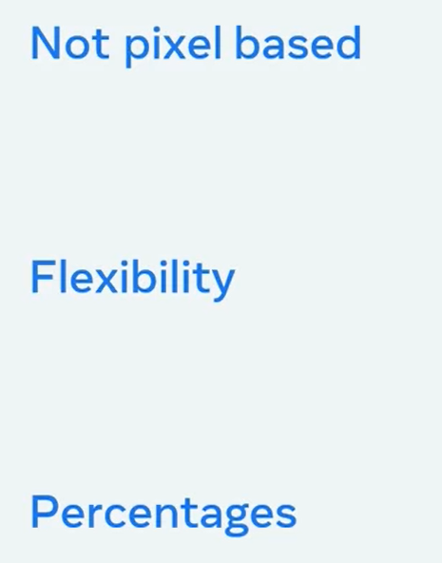
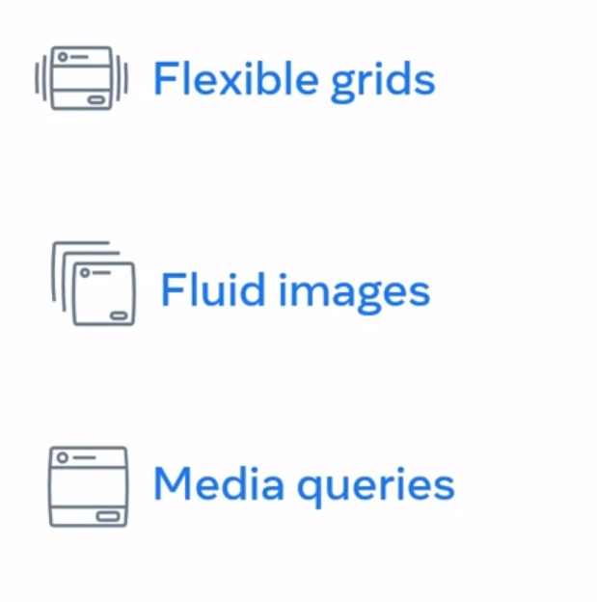
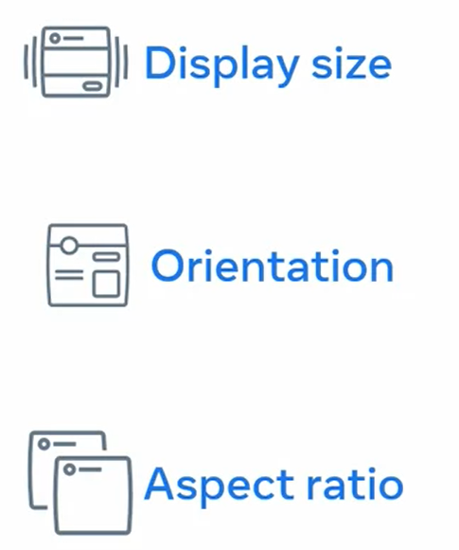
by setting the CSS max width property of images to 100%. The images will scale down smaller if they're containing column becomes narrower than the images size but never grow larger.

Slide 12
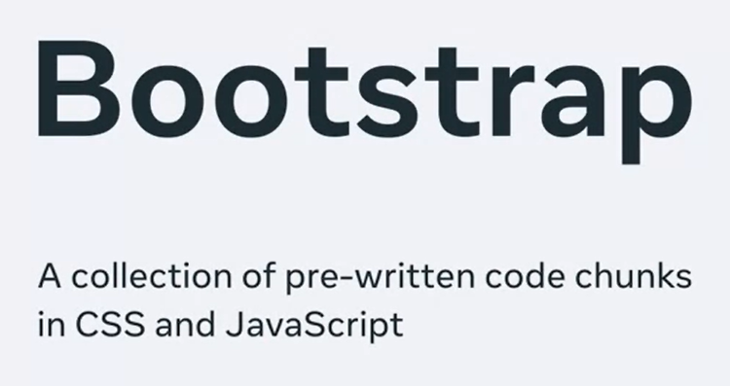
So, what is Bootstrap?
Simply put, Bootstrap is a library of CSS and JavaScript code that you can combine to quickly build visually appealing websites.

Slide 13
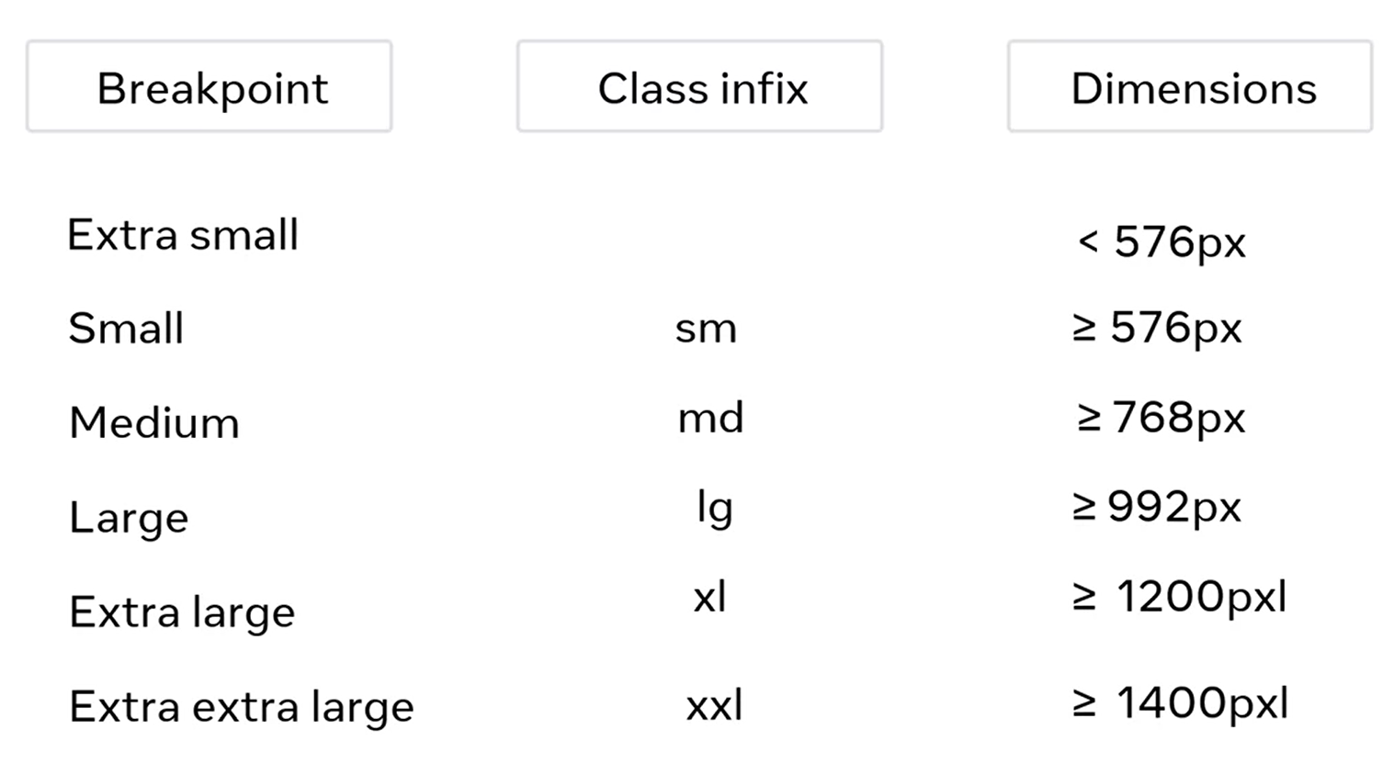

Slide 14
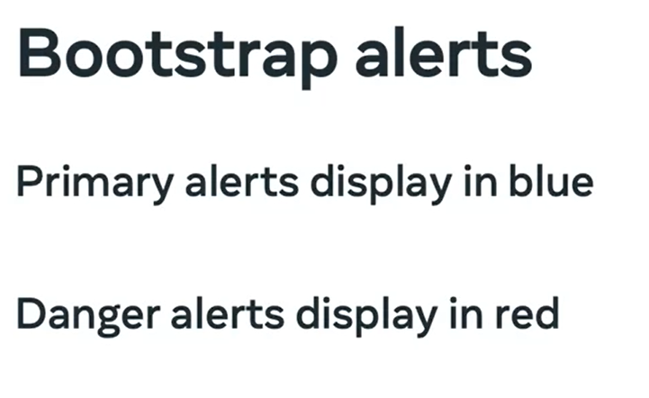
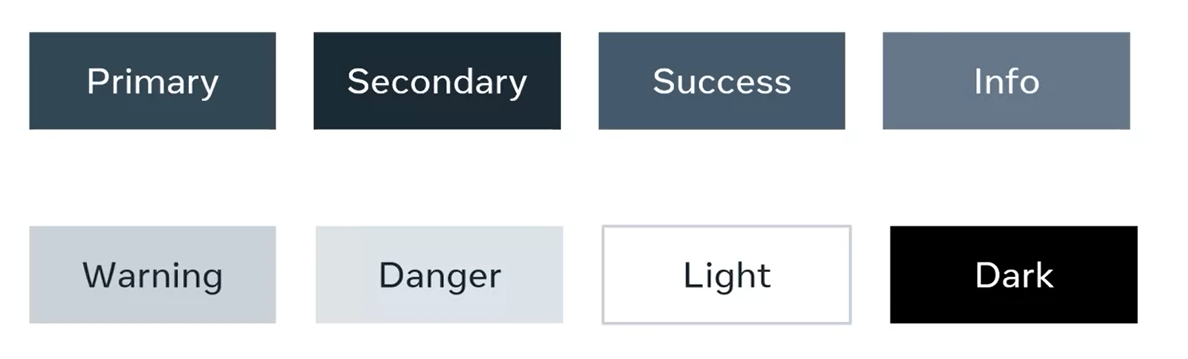
Using bootstrap style

Slide 15
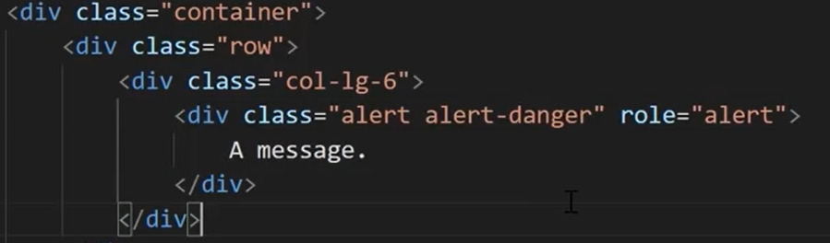
Modifier

Slide 16
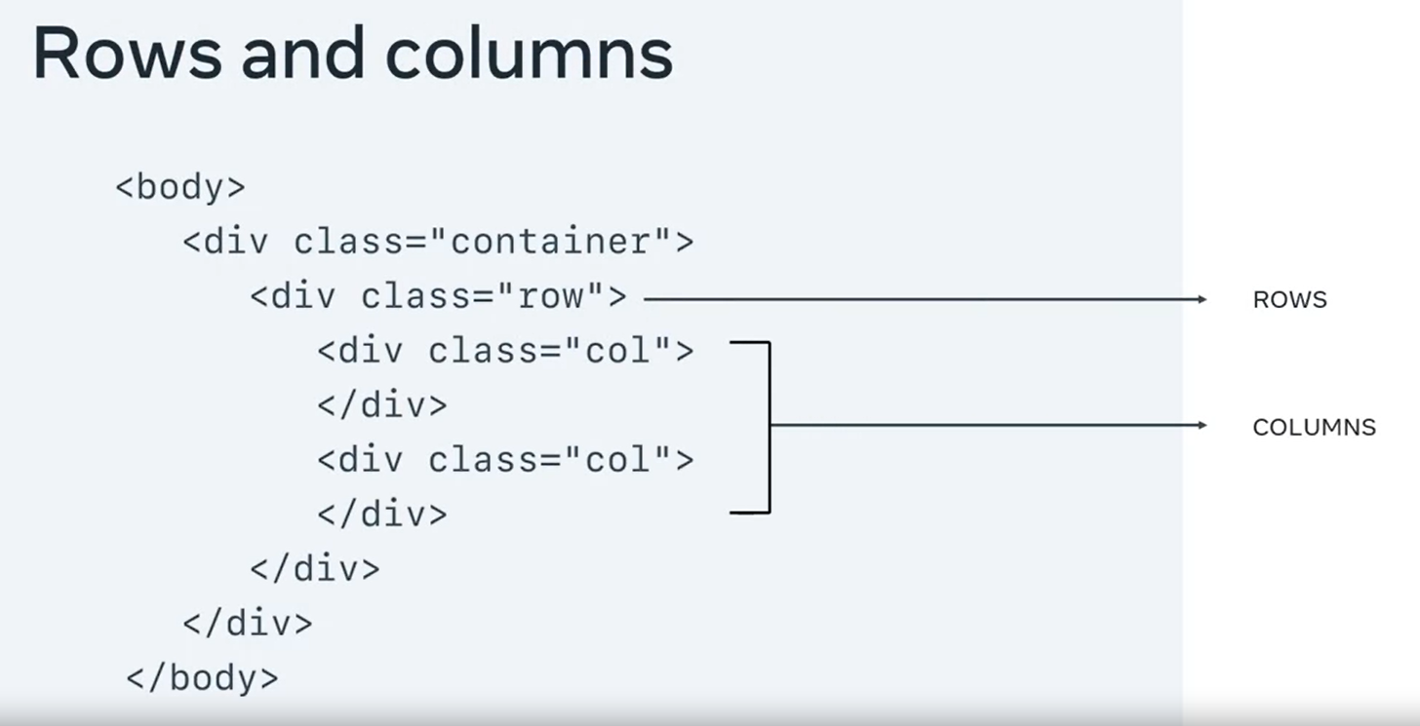

Slide 17
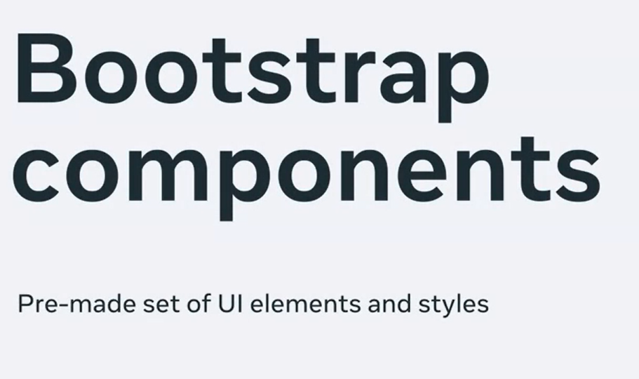

Slide 18
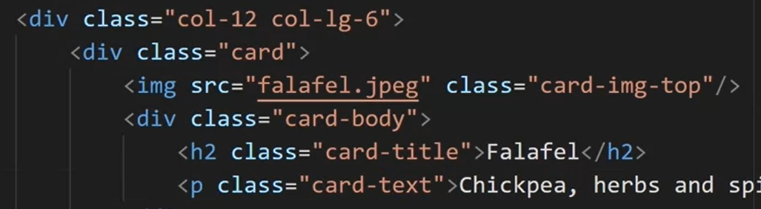
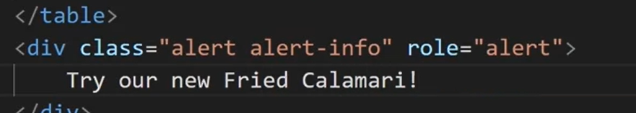

Slide 19
Using Bootstrap documentation
https://getbootstrap.com/docs

Slide 20

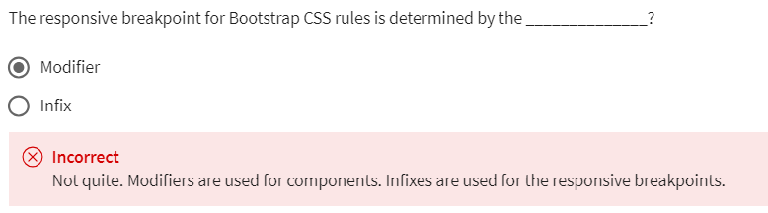
Knowledge check

